Slide 1


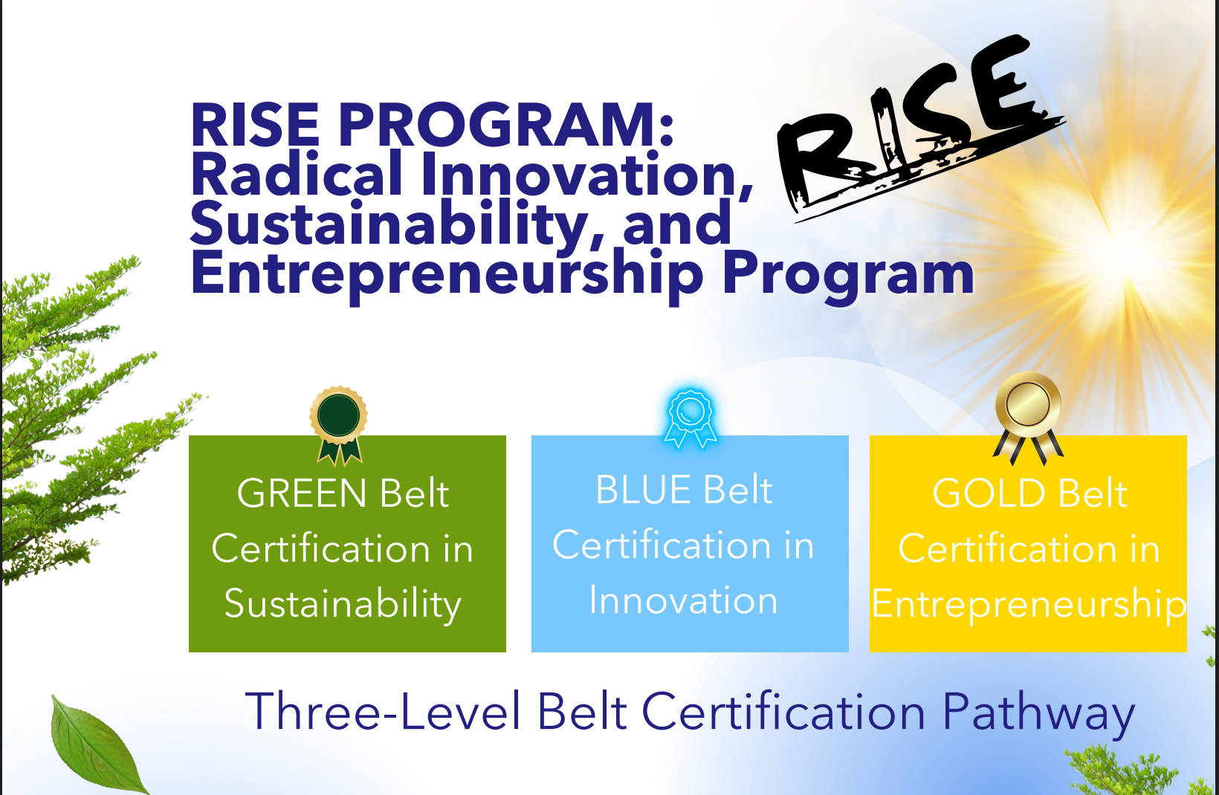

RISE Program
Radical Innovation Sustainability Entrepreneurship Program
Navjot Kaur
Chief of Staff, PurePlanet Global Ventures, LLC
Media & HR Head Guru Nanak Global Foundationi
June 9, 2026
Email: nkaur@gndgu.com

Slide 2

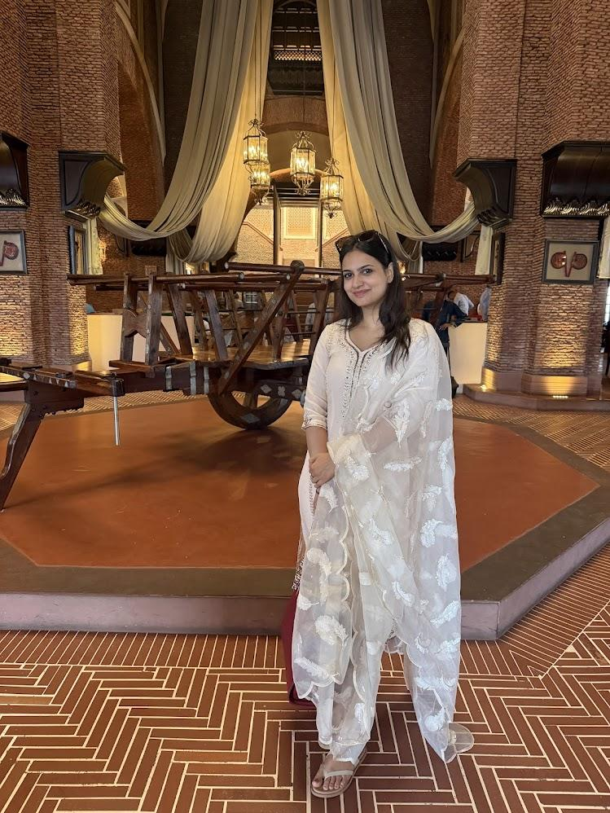
Navjot Kaur
Chief of Staff – PurePlanet Global Ventures LLC
Leads strategic planning, cross-functional execution, stakeholder engagement, and organizational initiatives supporting global business growth and innovation.
Media & Human Resources Head – Guru Nanak Global Foundation
Oversees media relations, brand communications, talent management, recruitment, and organizational culture across the Foundation’s programs and initiatives.
Strategic Communications Leader
Drives institutional storytelling, public relations, digital content strategy, and stakeholder communications to enhance organizational visibility and impact.
People & Culture Champion
Develops HR frameworks, employee engagement programs, leadership support systems, and talent development initiatives aligned with organizational goals.
Operations & Partnership Facilitator
Coordinates collaborations with educational institutions, corporate partners, media organizations, and community stakeholders to advance mission-driven projects and global outreach.
Chief of Staff, PurePlanet Global Ventures, LLC and
Media & HR Head, Guru Nanak Global Foundation

Slide 3
RISE PROGRAM: Radical Innovation, Sustainability,
and Entrepreneurship Program
Three-Level Belt Certification Pathway (Green – Blue – Gold)
Program Vision
To empower learners to build a sustainable future through knowledge, creativity, and enterprise,
progressing from understanding (Sustainability) to action (Innovation) to leadership (Entrepreneurship).
🟢 GREEN BELT
Sustainability
Foundation Track
─────────────────
6 Core Courses
Certification in Sustainability
🔵 BLUE BELT
Innovation
Applied Track
─────────────────
6 Core Courses
Certification in Innovation
🟡 GOLD BELT
Entrepreneurship
Leadership Track
─────────────────
2 Intensive Courses
FREE & Paid Internship

Slide 4
Why Innovation Matters
RISE Program | Blue Belt Track
✨ Why It Matters
💡 How It Helps You
The world needs problem-solvers:
Every major challenge needs creative, scalable solutions
Technology is evolving rapidly:
AI, IoT & biotech are reshaping every industry
Innovation drives growth:
Companies that innovate outperform those that don't 3x over
Master design thinking & creative methodologies
Transform ideas into viable, scalable solutions
Gain digital fluency across emerging technologies
Develop a portfolio of innovative projects
Collaborate across disciplines like top innovators do
"Innovation is seeing what everybody has seen and thinking what nobody has thought." — Turn vision into reality.

Slide 5
Why Sustainability Matters
RISE Program | Green Belt Track
✨ Why It Matters
💡 How It Helps You
Global challenges demand action:
Climate change, resource depletion & inequality are defining issues of our time
Industries are transforming:
Green jobs are the fastest-growing sector worldwide
Institutions value it:
ESG principles now guide corporate decisions globally
Build future-ready skills in green economy
Understand policies shaping tomorrow's industries
Stand out to employers committed to responsible growth
Develop critical thinking about long-term impact
Earn credentials recognized by global institutions
"The greatest threat to our planet is the belief that someone else will save it." — Act now, lead change.

Slide 6
Why Entrepreneurship Matters
RISE Program | Gold Belt Track
✨ Why It Matters
💡 How It Helps You
Job creation & economic growth:
Entrepreneurs create 65% of new jobs in growing economies
Independence & impact:
Own your future — build solutions that serve communities
The startup era is here:
Global startup ecosystem is worth over $3 trillion and growing
Launch real ventures with mentorship & funding support
Learn to pitch to investors and validate ideas
Build leadership, resilience & financial acumen
Earn a paid internship while building your startup
Graduate with a fundable business model in hand
"Entrepreneurship is living a few years of your life like most people won't, to spend the rest like most people can't." — Dare to build.

Slide 7
Track 1: Innovation
🔵 Blue Belt – Certification in Innovation | Track 1: Innovation
Theme: Applied Creativity, Technology & Sustainable Design
Goal:
Transform sustainable ideas into innovative, viable, and scalable ventures through applied design, technology, and strategy.

Slide 8
Track 1: Innovation
Track 1: Innovation | Blue Belt – Certification in Innovation
Courses: Each course listed below carries 1 credit hour.
1
Mastering Greatness Skills
4
Value Chain Analysis
2
Mastering Innovation pH Balance
5
Mastering Company Financials
3
Innovation Principles & Design Thinking
6
Digital Transformation and Emerging Technologies

Slide 9
Track 2: Sustainability
🟢 Green Belt – Certification in Sustainability | Track 2: Sustainability
Theme: Foundations of Sustainable Development & Global Responsibility
Goal:
Build awareness and systems understanding of global sustainability challenges and solutions. Students complete six core sustainability courses.

Slide 10
Track 3: Sustainability Courses
Track 2: Sustainability | Green Belt – Certification in Sustainability
Courses: Each course listed below carries 1 credit hour.
1
Ethical Foundations of Sustainable Development: Teachings of Guru Nanak Dev Ji
4
Sustainable Cities and Communities
2
Circular Economy and Resource Efficiency
5
Environmental Policy and Ethics
3
Climate Change and Renewable Energy
6
Sustainability Metrics and Reporting

Slide 11
Track 3: Entrepreneurship
🏆 GOLD Belt – Certification in Entrepreneurship | Track 3: Entrepreneurship
Theme: Leadership, Impact & Venture Creation
Goal:
Empower students to transform validated innovation ideas into real, fundable ventures through prototype development, business modeling, and investor engagement.
Prerequisites: Track 1: Innovation – Blue Belt | Track 2: Sustainability – Green Belt

Slide 12
Track 3: Entrepreneurship
Track 3: Entrepreneurship | GOLD Belt – Certification in Entrepreneurship
Courses:
1
Sustainable Venture Lab
2
Prototype Development and Market Validation
Program Structure: The GOLD Belt consists of two intensive courses.
🎉 There is NO Fee for this certification.
💰 Internship Stipend: INR 5,500 / month × 2 months (Summer)
To be taken during the summer and each student will be paid a internship stipend of INR 5,500 per month for two month.

Slide 13
Track 4: Language & Global Communications
🌐 Certification in Global Languages & Cross-Cultural Competence | Language & Global Communication (Multilingual Proficiency)
Theme: English, German & French with Cross-Cultural Etiquette & Global Mindset
Goal:
The Basic English Proficiency is mandatory. Students may take the proficiency exam for credits. Courses span English (entry to advanced), German (A1-B1), French (A1-B1), and Cross-Cultural Etiquette across Germany, France, USA & India.

Slide 14
Track 4: Language & Global Communications
Courses | Certification in Global Languages & Cross-Cultural Competence
Basic English Proficiency
Entry-level English grammar, vocabulary, reading, writing, and everyday conversation
German Language – Level 2 (A2–B1)
Intermediate communication, business German, and technical terminology
Advanced English for Academic & Professional Excellence
Advanced grammar, research paper writing, thesis writing, book writing, scholarly articles, and academic communication
French Language – Level 1 (A1–A2)
Basic grammar, conversation, and cultural awareness
Business English & Global Communication
Professional emails, presentations, negotiations, report writing, and workplace communication
French Language – Level 2 (A2–B1)
Intermediate French, professional communication, and negotiation skills
German Language – Level 1 (A1–A2)
Foundational grammar, basic conversation, and everyday vocabulary
Cross-Cultural Etiquette & Global Mindset
Understanding cultural nuances in Germany, France, USA & India, international business etiquette, protocol

Slide 15
Multiple Entry Point & Multiple Exit Program
ENTRY
Track 1: Blue Belt | Innovation
➤ Blue Belt Certification
EXIT
ENTRY
Track 2: Green Belt | Sustainability
➤ Green Belt Certification
ENTRY
Track 3: Gold Belt | Entrepreneurship
➤ Gold Belt Certification
ENTRY
Track 4: Language & Global Communication (Multilingual Proficiency)
➤ Language Certification

Slide 16
Fee Structure
Track 1: Blue Belt | Innovation
INR 5,500*
* 6 courses
Track 2: Green Belt | Sustainability
INR 5,500*
* 6 courses
Track 3: Gold Belt | Entrepreneurship
NIL
No Fee; INR 5,500 Internship to the Student for 2 months
Track 4: Language & Global Communication (Multilingual Proficiency)
INR 5,500*
* per course | Basic English Proficiency included in Green & Blue Belt

Slide 17
🏆 Prizes for Students
Track 1: Green Belt | Sustainability
📱 Free iPhone
Top 3 Students per year
Track 2: Blue Belt | Innovation
📱 Free iPhone
Top 3 Students per year
Track 3: Gold Belt | Entrepreneurship
💻 No Cost MacBook Neo
MacBook Neo given for use and to be returned.
Track 4: Language & Global Communication (Multilingual Proficiency)
📱 Free iPhone
Top 3 Students per year

Slide 18
FREE Courses | Available Starting July 2026
Course Overview: GEN-HS205 – Sustainability Career Options
What is it?
Who benefits?
What you gain?
GEN-HS205: Sustainability Career Options is an interdisciplinary course designed to help students explore emerging career pathways in sustainability, environmental responsibility, and green innovation. The course bridges theory with real-world application, enabling learners to understand how sustainability is shaping industries, policies, and future job markets across the globe.
The course highlights evolving roles within corporate, government, and non-profit ecosystems that are driving sustainability transformation. Learners gain clarity on skill requirements, professional opportunities, and future growth trends in sustainability-focused careers.
By the end of the course, students will be equipped with a clear understanding of sustainability-driven professions and a practical roadmap to pursue meaningful careers that contribute to environmental and social well-being.

Slide 19
Future FREE Courses | Technology Career Options
GEN-HS201
Technology Career Options
GEN-HS206
Innovation Career Options
GEN-HS210
Theater Career Options
GEN-HS202
Semiconductor Career Options
GEN-HS207
Datacenters Career Options
GEN-HS2011
Music Career Options
GEN-HS203
Artificial Intelligence Career Options
GEN-HS208
Program Manager Career Options
GEN-HS204
Quantum Physics Career Options
GEN-HS209
Liberal Arts Career Options

Slide 20
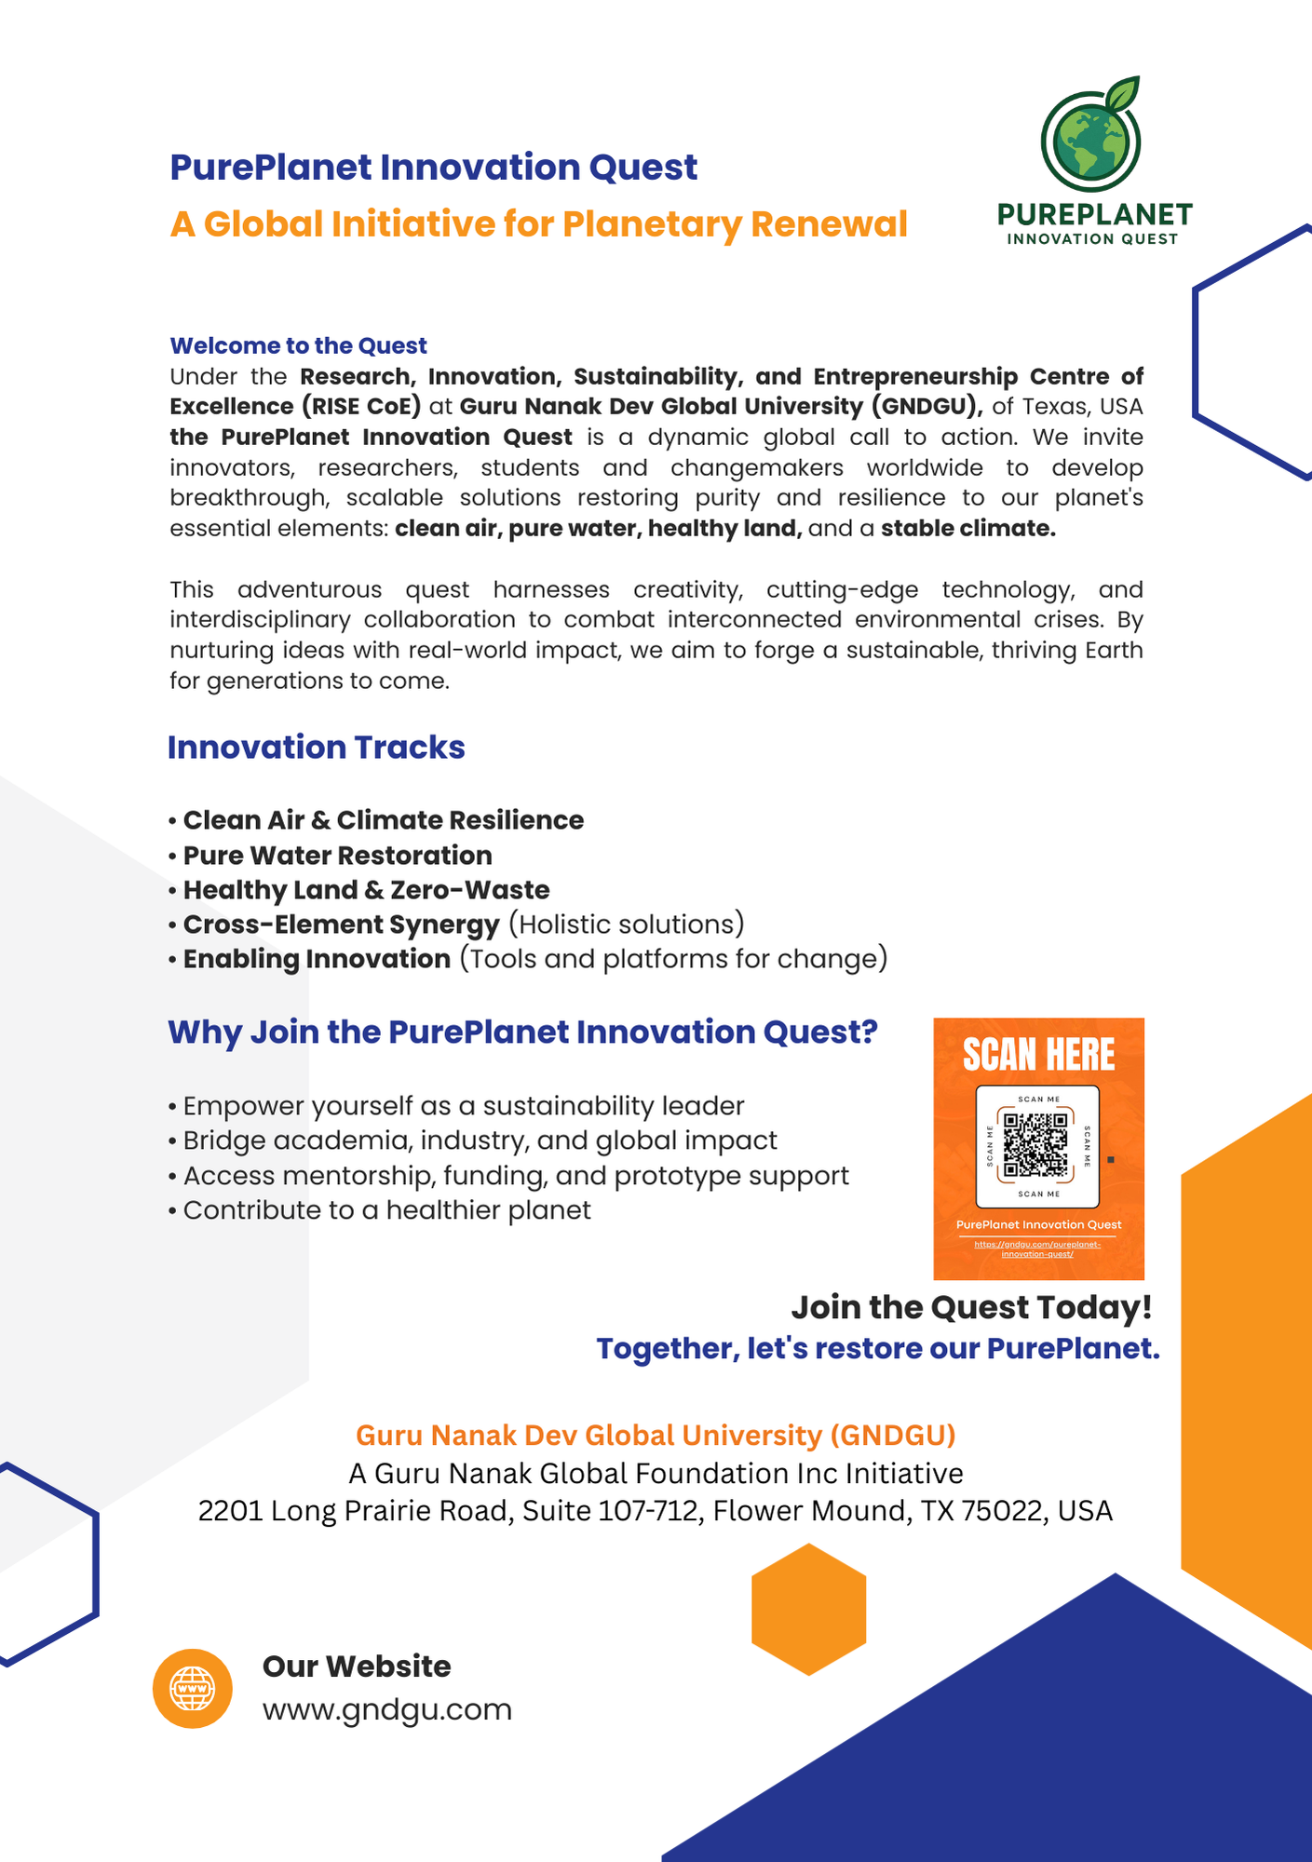
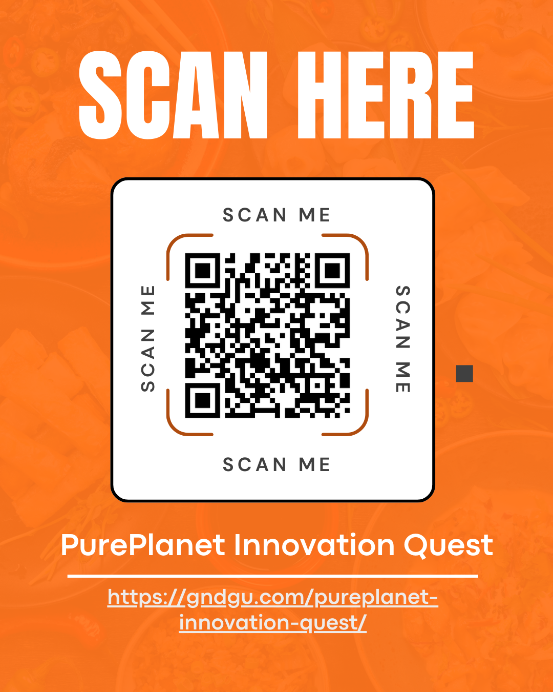
PurePlanet Innovation Quest
RISE
PUREPlanet Innovation Quest
© GNDGU

Slide 21
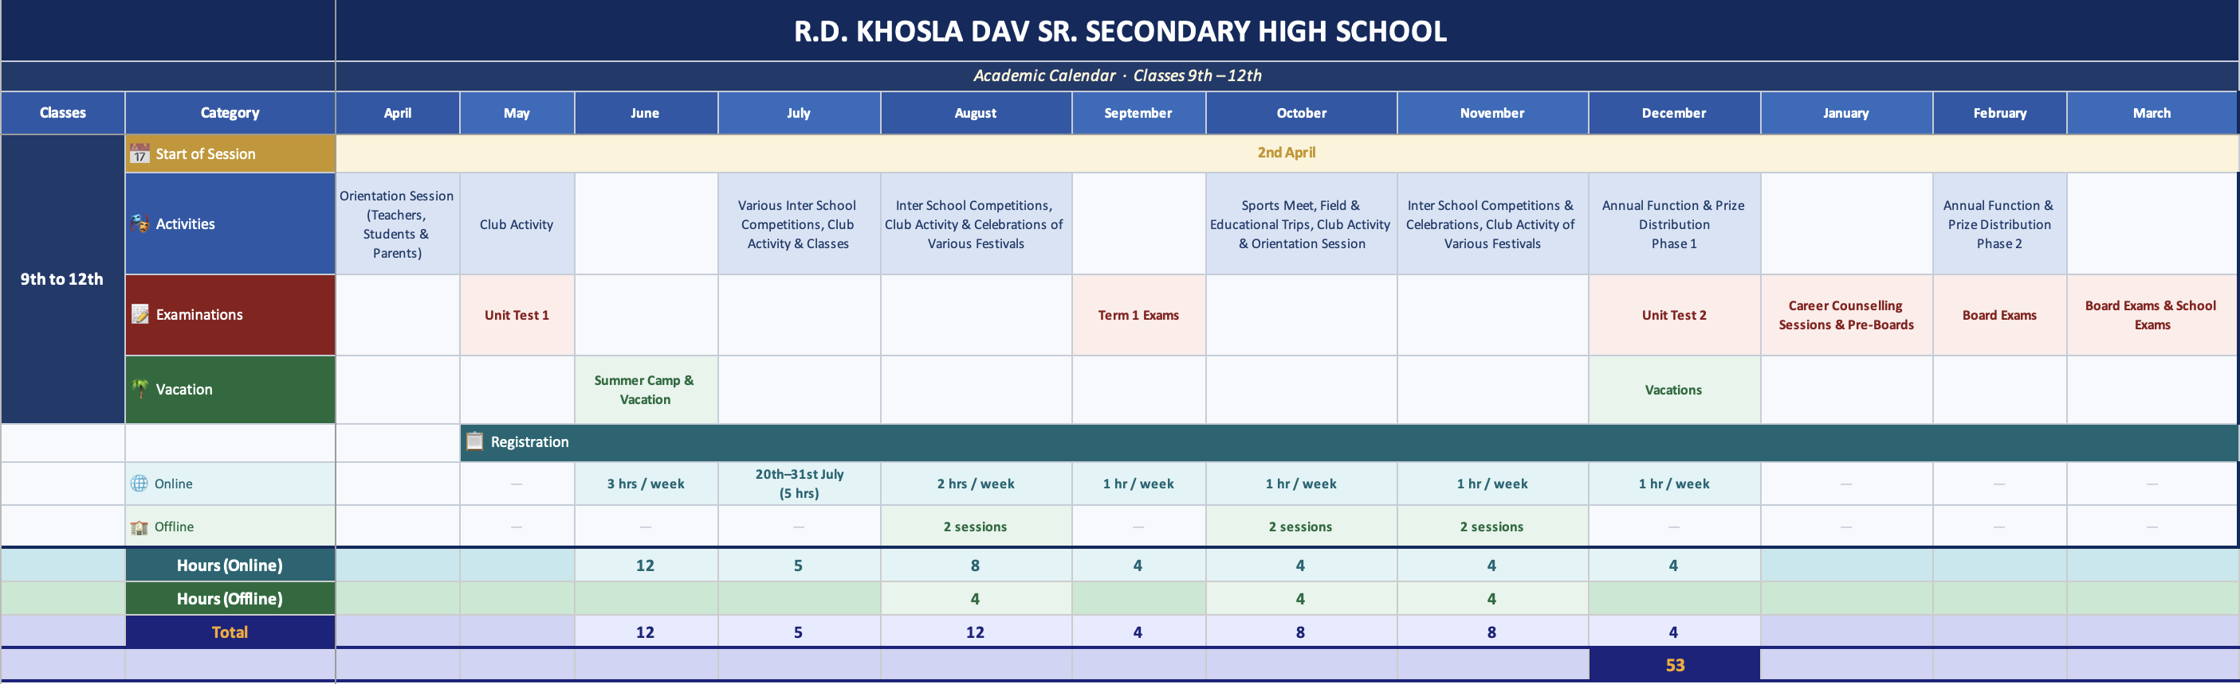
RISE Calendar
© GNDGU

Slide 22
Next Steps
1. Registration on the Learning Management System (LMS)
Email will be sent out to all learners by Friday (June 12, 2026)
Register on the LMS for online access.
2. WhatsApp RISE Group to be formed
No Action just FYI that a WhatsApp group for RISE will be formed for communication.
3. First online class for all learners
June 15th, 2026, 7:00p.m India time
4. Online & Offline Calendar
Will be published by June 15th 20206
© GNDGU

Slide 23

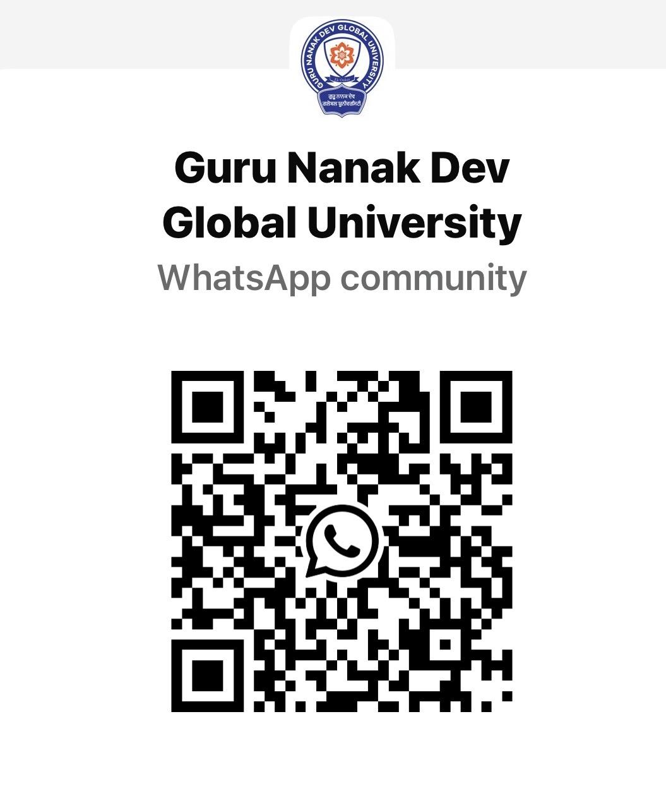
Guru Nanak Dev Global University
Flower Mound, Texas, USA
Join our WhatsApp Community to learn mere about the university activities
www.gndgu.com
Scan the QR Code and Join the Community.
© GNDGU

Slide 24
Guru Nanak Dev Global University
Flower Mound, Texas, USA
www.gndgu.com
Contact:
Navjot Kaur
Email: nkaur@gndgu.com
Chief of Staff, PurePlanet Global Ventures, LLC and
Media & HR Head, Guru Nanak Global Foundation
© GNDGU

